Slide 1

OWIN
Training
Rainer Stropek
software architects gmbh
Web
Mail
Twitter
http://www.timecockpit.com
rainer@timecockpit.com
@rstropek
Fundamentals

Slide 2
Introduction
Why did ASP.NET need such a radical change?

Slide 3

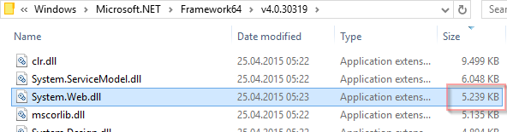
ASP.NET
Powerful but heavy
Slow release cycles
Bound to .NET
Once a year or every two years
Depends on System.Web
One of the largest DLLs in .NET
Bound to IIS
Exception: Mono
Alternatives are rising
In particular Node.JS

Slide 4
Node.JS
import http = require("http");
var server = http.createServer((req, resp) => {
console.log("Got request for " + req.url);
resp.writeHead(200, { "Content-Type": "text/html" });
resp.write('<!DOCTYPE "html"><html><body><h1>Hello from ');
resp.write(req.url);
resp.write('!</h1></body></html>');
resp.end();
});
server.listen(1337);
console.log("Listening on port 1337 ...");
https://nodejs.org/
Platform-independent
Windows, Linux, etc.
Performant
Async I/O
Event-driven
Flexible hosting
Light-weight, command line
Web servers like IIS (iisnode)
Note that this example uses Node.JS with TypeScript

Slide 5
Node.JS
import express = require('express');
var app = express();
app.get('/', (req, res) => {
res.send('Hello World!');
});
app.get('/customer/:id',(req, res) => {
var customer = {
customerId: req.params.id,
customerName: "Customer " + req.params.id
};
res.status(200).send(customer);
});
var server = app.listen(
1337,() => console.log("Listening on port 1337 ..."));
https://nodejs.org/
Modular approach
Add more libraries if needed
NPM as package manager
Here: Web API
Note that this example uses Express.js

Slide 6
OWIN Goals
IIS supported but not required
Self-hosting in console app, Windows service, etc.
Platform-independent
Not bound to Windows only
Standardized interface between .NET web server and app
For more information see http://owin.org/

Slide 7
The Very Basics
Fundamentals of OWIN

Slide 8
OWIN
using Microsoft.Owin.Hosting;
using Owin;
using System;
using System.Collections.Generic;
using System.Threading.Tasks;
using System.Web.Http;
namespace OwinSimpleServer
{
using AppFunc = Func<IDictionary<string, object>, Task>;
public class Program
{
static void Main(string[] args)
{
using (WebApp.Start<Program>("http://localhost:1337"))
{
Console.WriteLine("Listening ...");
Console.ReadKey();
}
}
Self-hosting
Microsoft.Owin.Hosting
Microsoft.Owin.Host. HttpListener

Slide 9
OWIN
using AppFunc = Func<IDictionary<string, object>, Task>;
…
public class Startup
{
public void Configuration(IAppBuilder app)
{
var middleware = new Func<AppFunc, AppFunc>(next =>
async env =>
{
var bytes = Encoding.UTF8.GetBytes(
"Hello OWIN!");
var headers = (IDictionary<string, string[]>)
env["owin.ResponseHeaders"];
headers["Content-Type"] = new[] { "text/html" };
var response = (Stream)env["owin.ResponseBody"];
await response.WriteAsync(bytes, 0, bytes.Length);
await next(env);
});
app.Use(middleware);
}
}
}
Middleware Foundation
Read more about application delegates or AppFuncs in OWIN spec
http://owin.org/spec/spec/owin-1.0.0.html

Slide 10
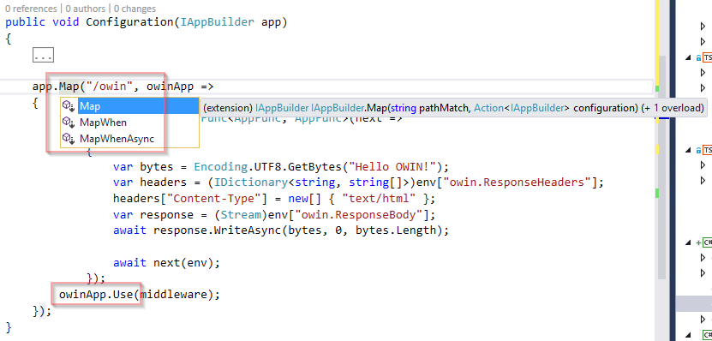
OWIN
Middleware
Conditional middleware execution
Map
MapWhen

Slide 11
Creating Middleware
How to create OWIN middleware

Slide 12
OWIN
public void Configuration(IAppBuilder app)
{
//app.Run(async context =>
await context.Response.WriteAsync("Hello!"));
app.Use(async (context, next) =>
{
await context.Response.WriteAsync("=== BEFORE ===");
await next();
await context.Response.WriteAsync("=== AFTER ===");
});
app.Map("/owin", owinApp =>
{
…
owinApp.Use(middleware);
});
}
Strong-typed middleware
Use IOwinContext
Run vs. Use
Use if you call downstream middleware
Run to “short-circuit” the pipeline
Note that you can add processing before and after calling the next pipeline

Slide 13
OWIN
public class HelloWorldMiddleware
{
private readonly AppFunc next;
private readonly HelloWorldOptions options;
public HelloWorldMiddleware(AppFunc next,
HelloWorldOptions options)
{
this.next = next;
this.options = options;
}
public async Task Invoke(IDictionary<string, object> env)
{
var context = new OwinContext(env);
context.Response.ContentType = "text/html";
await context.Response.WriteAsync(this.options.Greeting);
await this.next(env);
}
}
Middleware in separate class

Slide 14
OWIN
public class HelloWorldOptions
{
public string Greeting { get; set; }
}
public static class HelloWorldMiddlewareExtension
{
public static void UseHelloWorld(
this IAppBuilder app, HelloWorldOptions options)
{
app.Use<HelloWorldMiddleware>(options);
}
}
---------------------------------------------------------------
public class Startup
{
public void Configuration(IAppBuilder app)
{
…
app.UseHelloWorld(
new HelloWorldOptions() {
Greeting = "Hello from Middleware Class"
}));
…
}
}
Middleware in separate class

Slide 15
Advanced Topics
Adding response headers in middleware
Problem: Response headers are sent with the first write to response body stream
Solution: context.Response.OnSendingHeaders callback
Reading request or response body
Influences downstream middleware
Solution: Buffer body stream in MemoryStream

Slide 16
Using Middleware
How to use existing middleware

Slide 17
OWIN
public void Configuration(IAppBuilder app)
{
var config = new HttpConfiguration();
config.MapHttpAttributeRoutes();
app.UseWebApi(config);
app.Run(async context =>
{
…
});
}
--------------------------------------------------------------
public class CustomerController : ApiController
{
[Route("customer/{id}")]
public IHttpActionResult GetCustomer(string id)
{
return this.Ok(
new { customerId =id, customerName =$"Customer {id}" });
}
}
Compose existing middleware
Microsoft.AspNet.WebApi.OwinSelfHost
Other interesting OWIN middleware
Microsoft.Owin.Cors
Microsoft.Owin.Security.*
Microsoft ASP.NET SignalR OWIN
Microsoft.Owin.Diagnostics
Microsoft.Owin.FileSystems
Microsoft.Owin.StaticFiles
Microsoft.Owin.Testing

Slide 18
What’s next? ASP.NET V_{next}
What does ASP.NET V_{next} change?

Slide 19
Many things changed
Project system
Configure project in project.json
For details see https://github.com/aspnet/Home/wiki/Project.json-file
Interfaces, class names, namespaces, etc.
E.g. IAppBuilder → IApplicationBuilder
It is now platform independent ☺
Further readings
http://docs.asp.net/en/latest/getting-started/index.html

Slide 20
ASP.NET V_{next}
public class Startup
{
public void ConfigureServices(IServiceCollection services)
{
services.AddMvc();
}
public void Configure(IApplicationBuilder app)
{
app.UseMvc();
…
}
}
public class CustomerController : Controller
{
[Route("customer/{id}")]
public IActionResult GetCustomer(string id)
{
return new ObjectResult(
new { customerId = id,
customerName = $"Customer {id}" });
}
}
MVC and Web API have been consolidated

Slide 21
ASP.NET V_{next}
app.Map("/site", siteApp =>
{
siteApp.UseFileServer(new FileServerOptions
{
FileProvider = new PhysicalFileProvider(
Path.Combine(Directory.GetCurrentDirectory(),
"wwwroot")),
EnableDirectoryBrowsing = true
});
});
app.Use(async (context, next) =>
{
await context.Response.WriteAsync("=== BEFORE ===");
await next();
await context.Response.WriteAsync("=== AFTER ===");
});
app.Run(async (context) =>
{
Console.WriteLine(
$"Got request for {context.Request.Path}");
await context.Response.WriteAsync(
$@"<!DOCTYPE 'html'><html><body><h1>Hello from {
context.Request.Path }!</h1></body></html>");
});
Many things work as usual
Here: Static file server
Use and Run

Slide 22
ASP.NET V_{next}
{
"webroot": "wwwroot",
"version": "1.0.0-*",
"dependencies": {
"Microsoft.AspNet.Hosting": "1.0.0-beta4",
"Microsoft.AspNet.Server.WebListener": "1.0.0-beta4",
"Microsoft.AspNet.Mvc": "6.0.0-beta4",
"Microsoft.AspNet.StaticFiles": "1.0.0-beta4",
"Microsoft.AspNet.FileProviders": "1.0.0-beta4"
},
"commands": {
"web": "Microsoft.AspNet.Hosting --server Microsoft.AspNet.Server.WebListener --server.urls http://localhost:1337"
},
"frameworks": {
"dnx451": { },
"dnxcore50": {
"dependencies": {
"System.Console": "4.0.0-beta-22816"
}
}
}
}
Project configuration

Slide 23
ASP.NET V_{next}
dnvm list
dnvm upgrade -arch x64 -r coreclr
dnvm use 1.0.0-beta4-11566 -arch x64 -r coreclr
---------------------------------------------------------------------
dnu restore
---------------------------------------------------------------------
dnx . web
Manage .NET runtimes
Manage referenced packages
Run using .NET runtime

Slide 24
Summary
Server-side development has drastically changed
OWIN was a first step
Modular, light-weight, self-hosting, etc.
ASP.NET V_{next} adds even more
Platform independence, Core CLR, etc.
Sample Code
https://github.com/rstropek/Samples/tree/master/OwinFundamentals

Slide 25
Q&A
Training
Rainer Stropek
software architects gmbh
Mail Web Twitter
rainer@timecockpit.com http://www.timecockpit.com @rstropek
Thank your for coming!

